Slide 1
Promoting language competence and cultural awareness through blogging in a Chinese language course
Zhou Hongfen
Hongfen.zhou@manchester.ac.uk

Slide 2
Training students successfully in a global world
content–based learning
cultural awareness for the preparation for real-world language use

Slide 3
CONTENTS
AIM
PARTICIPANTS
COURSE BLOG
QUESTIONAIRE
FINDINGS

Slide 4
AIM
To explore closely how to use course blog as an educational tool in an interactive way for the development of learners’ language competence and cultural awareness
Writing skills, Cultural awareness , Course blog

Slide 5
PARTICIPANTS
Undergraduates in intermediate advanced
Chinese course
Language tutor acting as a participant and facilitator
All students having Chinese related experience

Slide 6
COURSE BLOG
Each participant could post their entries and leave comments in one blog to share with others
All entries are displayed in one page
Task writing & free writing

Slide 7
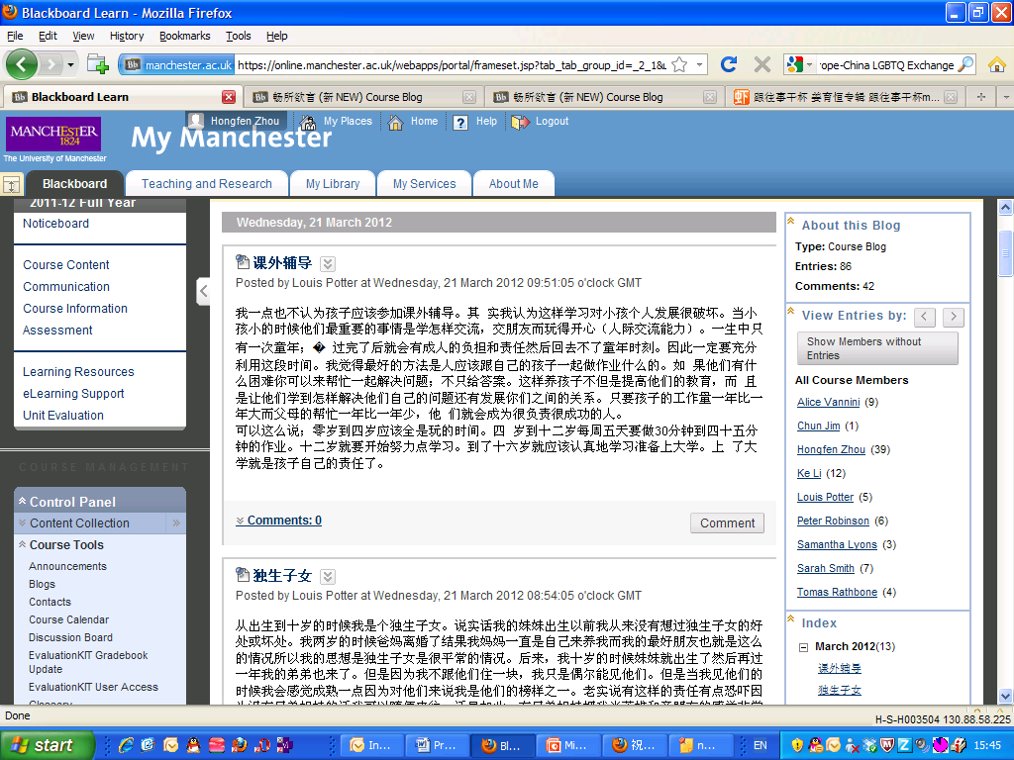

Slide 8
THE ANALYSIS ON THE CATEGORIES OF COURSE BLOG
Task Writing
Female social status in China and in your home country
Chinese new year and Christmas
Learning burden
One child policy
Chinese medicine and Western medicine
Free Writing
Website recommendation
Holiday diary
Hot topic
News
Notice board

Slide 9
THE ANALYSIS ON THE CATEGORIES OF COURSE BLOG

Slide 10
QUESTIONAIRE
Post-survey
85% students like to read blog entries and 28% student like to write blog entries, 57% students keep neutral attitude to the blog entries writing
71% students agreed that learned new vocabularies, improved their language and enriched their cultural knowledge about China
71% students keep the neutral attitude for gaining diverse cultural perspectives by using course blog
57% students feel their communication skills increased
Pre-survey
No one used blog for personal use or educational purpose before
Hope to get interesting and useful information from course blog
Learn more culture
Get feedback about their essay from course blog to learn more phrases and culture

Slide 11
FINDINGS
Using course blog effectively improved students’ language competence
The course blog helped students to improve their cultural awareness, but its function of developing students’ diverse cultural perspectives was not as effective as expected
Course blog should be used together with class group discussions or debates

Slide 12
QUESTIONS?

